Slide 1
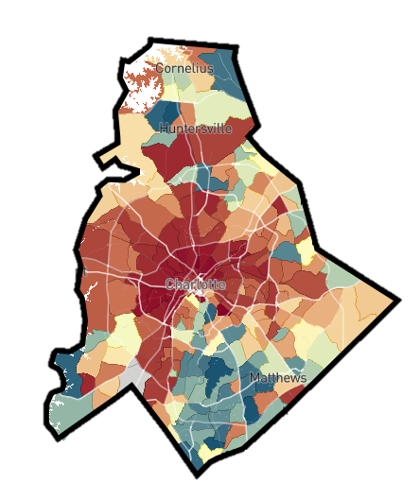




Three Policy Approaches to Increasing Upward Mobility
Reducing
Segregation
Place-Based
Investments
Higher Education & Workforce Training
Help Low-Income
Families Move to
High-Opportunity Areas
Increase Upward Mobility in Low-Opportunity Areas
Amplify Impacts of Colleges and Training Programs on Mobility

Slide 2
The Contribution of Colleges to Economic Mobility in North Carolina
Upward Mobility vs. Low-Income Access
Source: Chetty, Friedman, Saez, Turner, Yagan (2020)
Notes:
Customize to where you’re presenting if possible

Slide 3
The Contribution of Colleges to Economic Mobility in North Carolina
Upward Mobility vs. Low-Income Access
Source: Chetty, Friedman, Saez, Turner, Yagan (2020)

Slide 4


Slide 5
Impact of Year Up on Earnings
Evidence from PACE Randomized Trial in 2014
$50K
Treatment
Control
$40K
$30K
NOT YET PUBLIC
Mean W-2 Wage Earnings
$20K
$10K
0
2010
2011
2012
2013
2014
2015
2016
2017
2018
2019
2020
2021
2022
Year
Source: Chetty, Katz, Noray, Porter, Reisinger (2025)
Notes:
Not yet published, can present but must be removed if slides are made public after presentation

Slide 6
Impact of Year Up on Earnings
Evidence from PACE Randomized Trial in 2014
$50K
Treatment
Control
Participants
enrolled
in YearUp
$40K
$30K
NOT YET PUBLIC
Mean W-2 Wage Earnings
$20K
$10K
0
2010
2011
2012
2013
2014
2015
2016
2017
2018
2019
2020
2021
2022
Year
Source: Chetty, Katz, Noray, Porter, Reisinger (2025)
Notes:
Not yet published, can present but must be removed if slides are made public after presentation

Slide 7
Impact of Year Up on Earnings
Evidence from PACE Randomized Trial in 2014
$50K
Treatment
Control
Participants
enrolled
in YearUp
$40K
YearUp Increases Earnings by $9,000/year
$30K
NOT YET PUBLIC
Mean W-2 Wage Earnings
$20K
$10K
0
2010
2011
2012
2013
2014
2015
2016
2017
2018
2019
2020
2021
2022
Year
Source: Chetty, Katz, Noray, Porter, Reisinger (2025)
Notes:
Not yet published, can present but must be removed if slides are made public after presentation

Slide 8

Lost Einsteins
4x
If women, minorities, and children from low-income families invent at the same rate as high-income white men, the innovation rate in America would quadruple
Source: Bell, Chetty, Jaravel, Petkova, van Reenen (QJE 2020)
Notes:
8

Slide 9
Patent Rates vs. Parent Income
Patent rate for top 1% parent income:
8.3 per 1,000
8
6
4
Inventors per 1000 Children
2
Patent rate for below
median parent income:
0.84 per 1,000
0
0
20
40
60
80
100
Parent Household Income Percentile
Source: Bell, Chetty, Jaravel, Petkova, van Reenen (QJE 2020)

Slide 10

Entrepreneurship Rates by Parental Income
Share of Individuals who Found High-Revenue, High-Employment Businesses
3.0
Children of parents in top 1% are 20 times more likely to found a high-employment business than those with below-median parent income
2.25
NOT YET PUBLIC
Star Entrepreneurs per 1000 children
1.5
0.75
0
0
20
40
60
80
100
Parent Household Income Percentile
Source: Chetty, Dossi, Smith, van Reenen, Zidar, Zwick (2025)

Slide 11
Additional slides for education-specific presentations (not usually included in general EOP)

Slide 12

Mobility Report Cards: Del Mar College
30%
Success Rate
Fraction of Students who Reach Top Fifth
From Parents in Bottom Fifth = 16.4%
20%
Percent of Students
Access
Fraction of Parents from
Bottom Fifth = 11.6%
10%
0%
< $25K
25-47K
47-74K
74-111K
> $111K
Parent Income Quintile
Notes:
Customize to where you’re presenting if possible

Slide 13







A Data-Driven Approach to Upward Mobility through College
K-12 Education
College Awareness and Application
Mentorship
(Social Capital)
Community College
Transfer to 4-year college
Transition to Workforce
Sector-Specific Training

Slide 14








A Data-Driven Approach to Upward Mobility through College
K-12 Education
College Awareness and Application
Mentorship
(Social Capital)
Community College
Transfer to 4-year college
Transition to Workforce
Sector-Specific Training

Slide 15


SEEK Program at the City University of New York
Program for low-income students across CUNY campuses:
6-week pre-term summer program
Individual tutoring
Access to “opportunity counselors”
Available to academically marginal students from low-income families
Notes:
XX do we have a similar slide to this for Year Up?

Slide 16
Impact of SEEK Advising Program on Upward Mobility for Students
30
24.3%
25
Percent of Students from Bottom 20%
who Reach Top 20%
Upward Mobility Rate
21.0%
20
15
Ineligible
(Higher Income)
Eligible
(Lower Income)

